Slide 1


ECEN 403
Team #44
Cubesat EM Material Discharge Eval:
Joshua Feldman
Michael Kim
Ian Poynter
Alejandro Torres
Sponsor: Orbital Arc & SATOP
TA: Peng-Hao Huang

Slide 2
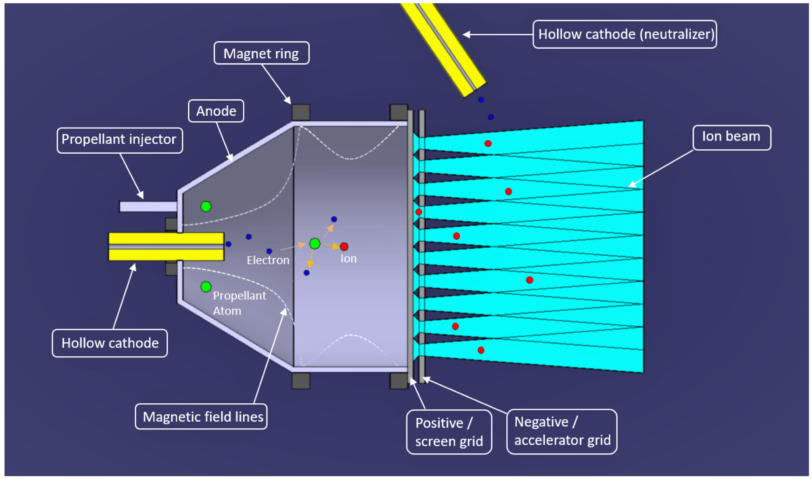
Current Ion Thrusters
Current ion thrusters require expensive fuel, have extremely low acceleration, and require electron bombardment for ionization.

Slide 3
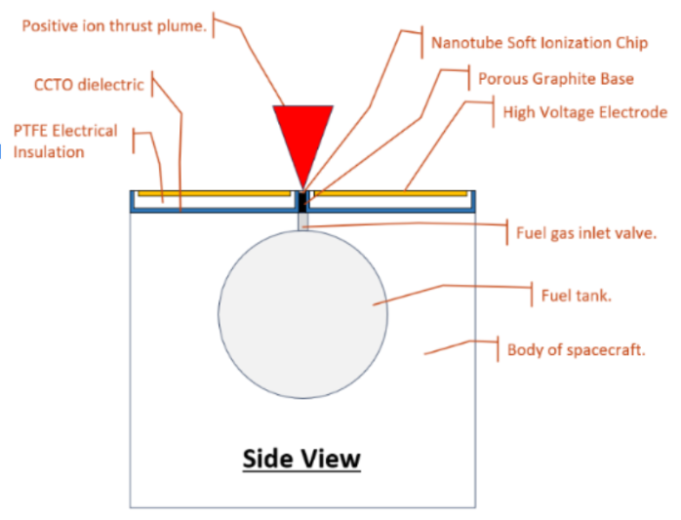
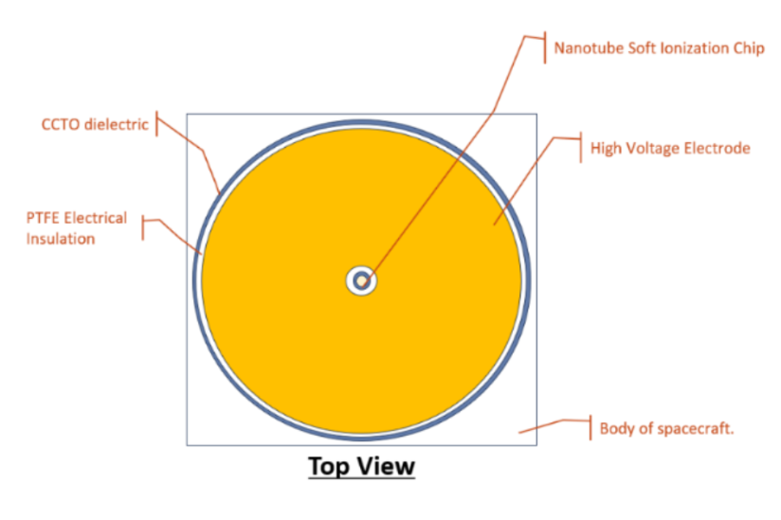
RIOT Drive
Develop a prototype for the RIOT Drive, an ion thruster that can use cheaper fuel and will operate at about 4 times the efficiency of contemporary ones.

Slide 4
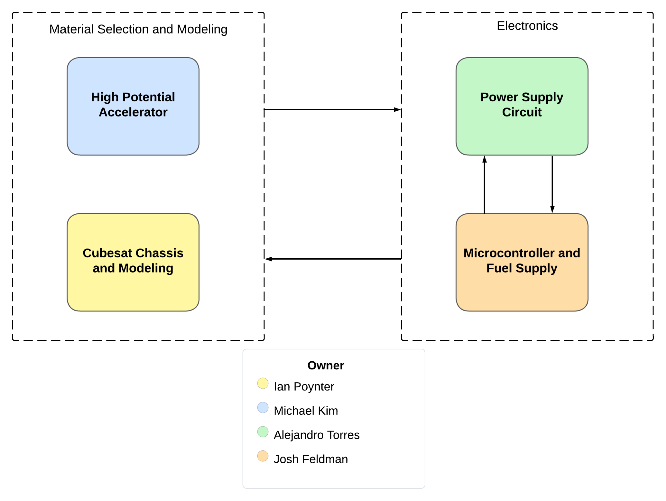
Diagram of Subsystems and Interface

Slide 5
Task Partition
Michael: Accelerator Plate & Shielding
Josh: Microcontroller and Fuel Supply
Alejandro: Power Supply Circuit
Ian: CubeSat Chassis and Modeling

Slide 6
Accelerator Plate and Shielding
-Materials and geometries are tested for one combination for final project.
-Materials are specifically chosen to be space launch ready.
-Geometries are designed for electric field optimization.
-Internal components are shielded from voltage of the accelerator.
Geometries | Materials
Circular Plane | Copper
Hemisphere | Aluminum
Parabolic Pyramid | Titanium

Slide 7
Microcontroller
Will regulate fuel flow to ionizer chips.
Will time the pulse charger for the accelerator plate.
Enables the accelerator, ionizer, and thermionic cathode.

Slide 8
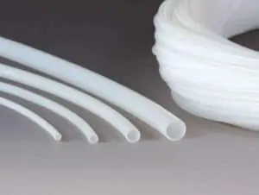
Fuel Supply
Gas fuel line will be composed of PTFE tubing
Fuel valve will interface with microcontroller to regulate fuel delivery
Multiple tubing sizes will be tested

Slide 9
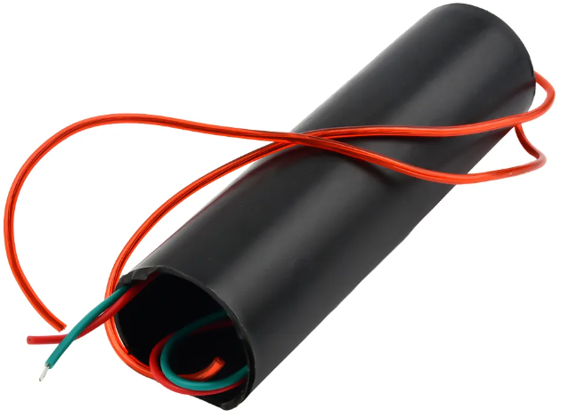
Power Supply Circuit
50W power budget
24V Input
Outputs
High Voltage Accelerator
Needs 3-6V to be boosted to 100 kV using a Pulse Generator
Thermionic Cathode
3-6V
Ionizer Chips
33V
Microcontroller
3.3V
DAC
3V
Gas Feed Control

Slide 10
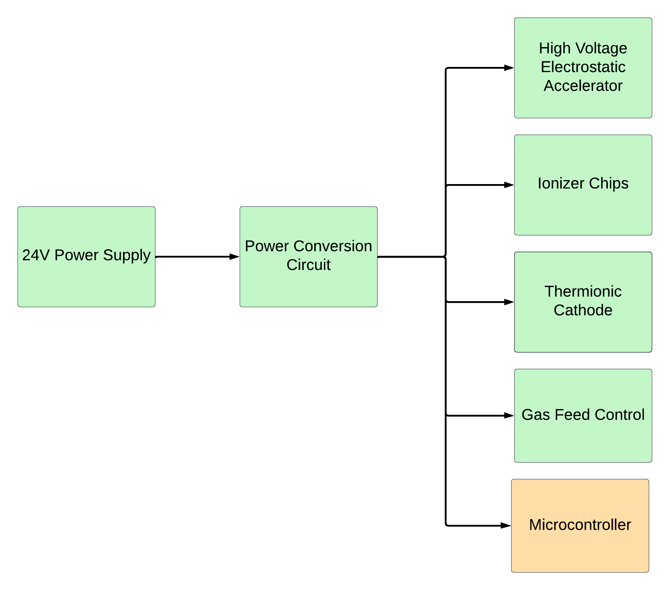
Power Supply Circuit Breakdown

Slide 11
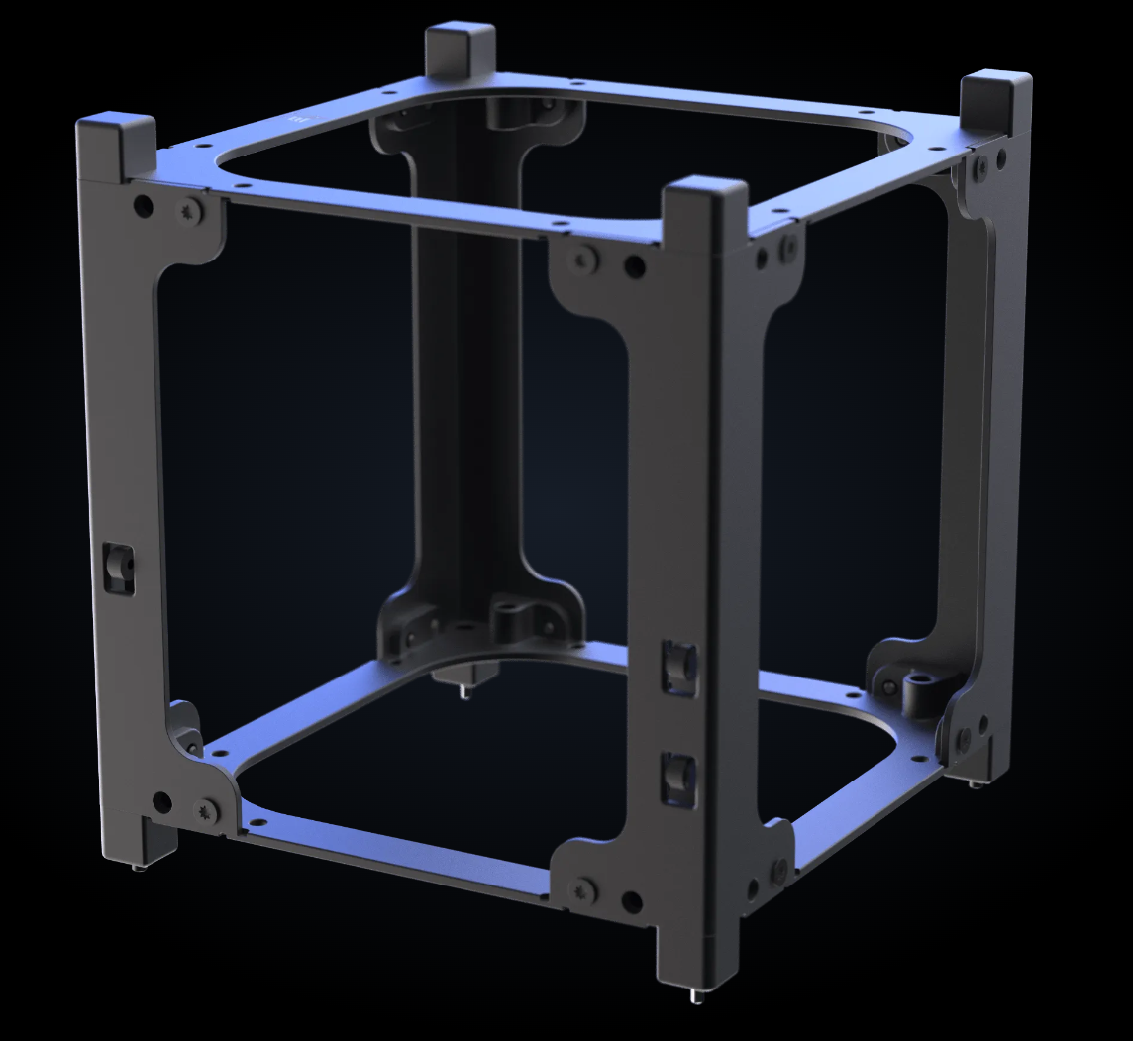
CubeSat Chassis and Modeling
Footprint of prototype must fit within 1U CubeSat
Mounting locations for subsystems
Responsible for risk calculations

Slide 12
Limitations
Ionizer chips will not be provided for the prototype
Must fit within one unit of a CubeSat
Restrictive specifications for multiple components
Sponsor may request that additional materials be tested

Slide 13
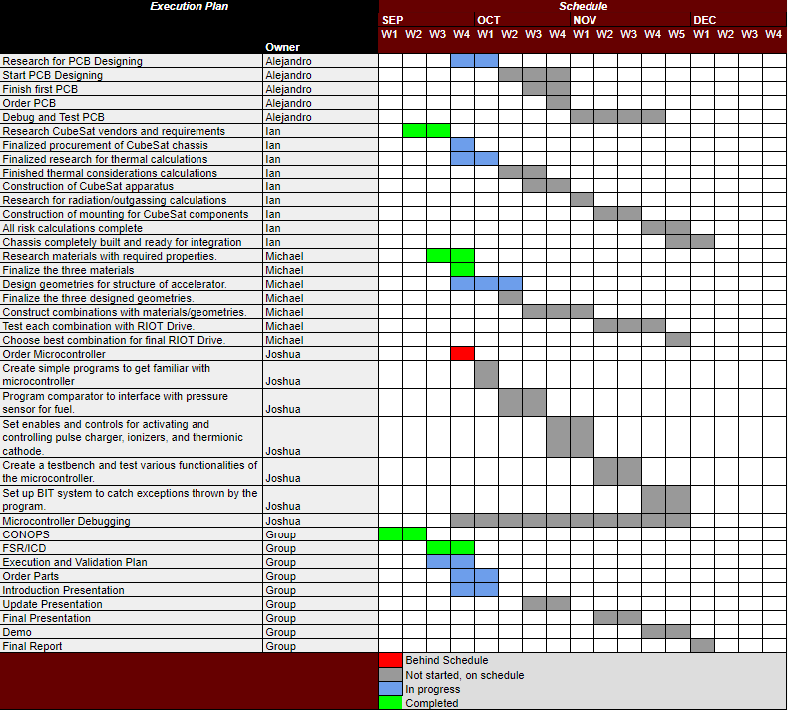
Execution Plan

Slide 14
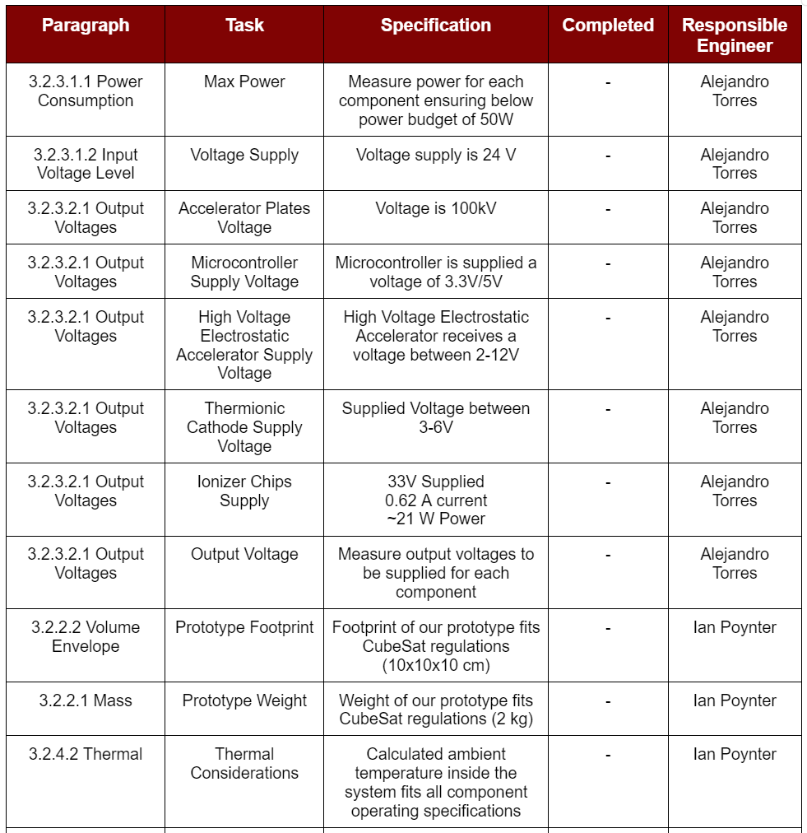
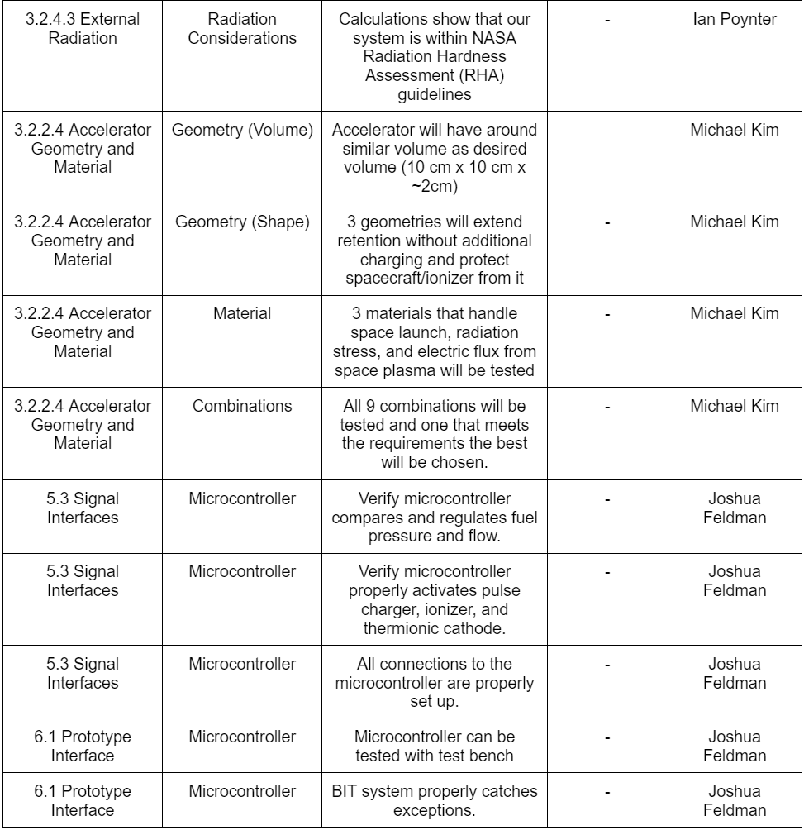
Validation Plan

Slide 15
Questions?

Slide 16
Thank You

Slide 17
References
https://orbitalarc.com/
https://www.mdpi.com/2076-3417/13/9/5600
https://www.aliexpress.us/item/3256805375098239.html?gatewayAdapt=glo2usa4itemAdapt

